Slide 1
System Software by Leland L. Beck chapter 1, pp.1-20.

Slide 2
Outline of Chapter 1
System software consists of variety of programs that support the operation of a computer.

Slide 3
System Software vs. Machine Architecture
Machine dependent
The most important characteristic in which most system software differ from application software
e.g. assembler translate mnemonic instructions into machine code
e.g. compilers must generate machine language code
Machine independent
There are aspects of system software that do not directly depend upon the type of computing system
e.g. general design and logic of an assembler
e.g. code optimization techniques

Slide 4
The Simplified Instructional Computer (SIC)
SIC is a hypothetical computer that includes the hardware features most often found on real machines
Two versions of SIC
standard model
extension version

Slide 5
SIC Machine Architecture (1/5)
Memory
2¹⁵ bytes in the computer memory
3 consecutive bytes form a word
8-bit bytes
Registers

Slide 6
SIC Machine Architecture (2/5)
Data Formats
Integers are stored as 24-bit binary numbers; 2’s complement representation is used for negative values
No floating-point hardware
Instruction Formats
Addressing Modes
opcode (8)
x
address (15)

Slide 7
SIC Machine Architecture (3/5)
Instruction Set
load and store: LDA, LDX, STA, STX, etc.
integer arithmetic operations: ADD, SUB, MUL, DIV, etc.
All arithmetic operations involve register A and a word in memory, with the result being left in the register
comparison: COMP
COMP compares the value in register A with a word in memory, this instruction sets a condition code CC to indicate the result

Slide 8
SIC Machine Architecture (4/5)
Instruction Set
conditional jump instructions: JLT, JEQ, JGT
these instructions test the setting of CC and jump accordingly
subroutine linkage: JSUB, RSUB
JSUB jumps to the subroutine, placing the return address in register L
RSUB returns by jumping to the address contained in register L

Slide 9
SIC Machine Architecture (5/5)
Input and Output
Input and output are performed by transferring 1 byte at a time to or from the rightmost 8 bits of register A
The Test Device (TD) instruction tests whether the addressed device is ready to send or receive a byte of data
Read Data (RD)
Write Data (WD)

Slide 10
SIC Programming Examples
Data movement Fig. 1.2
Arithmetic operation Fig. 1.3
Looping and indexing Fig. 1.4, Fig. 1.5
Input and output Fig. 1.6
Subroutine call Fig. 1.7

Slide 11
SIC Programming Examples (Fig 1.2) -- Data movement
ALPHA RESW 1
FIVE WORD 5
CHARZ BYTE C’Z’
C1 RESB 1
.
.
LDA FIVE
STA ALPHA
LDCH CHARZ
STCH C1
(a)
No memory-memory move instruction
3-byte word:
LDA, STA, LDL, STL, LDX, STX
1-byte:
LDCH, STCH
Storage definition
WORD, RESW
BYTE, RESB

Slide 12
SIC Programming Examples (Cont.)
All arithmetic operations are performed using register A, with the result being left in register A.
BETA=ALPHA+INCR-ONE
DELTA=GAMMA+INCR-ONE

Slide 13
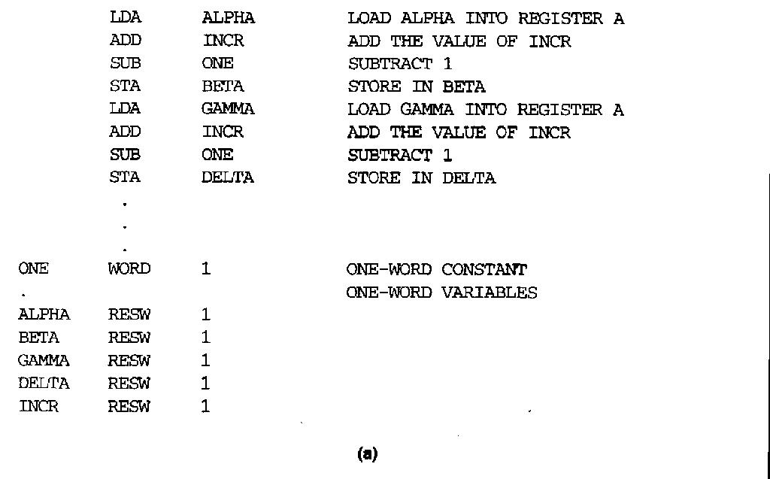
SIC Programming Example -- Arithmetic operation (Fig 1.3)
BETA=ALPHA+INCR-ONE
DELTA=GAMMA+INCR-ONE

Slide 14
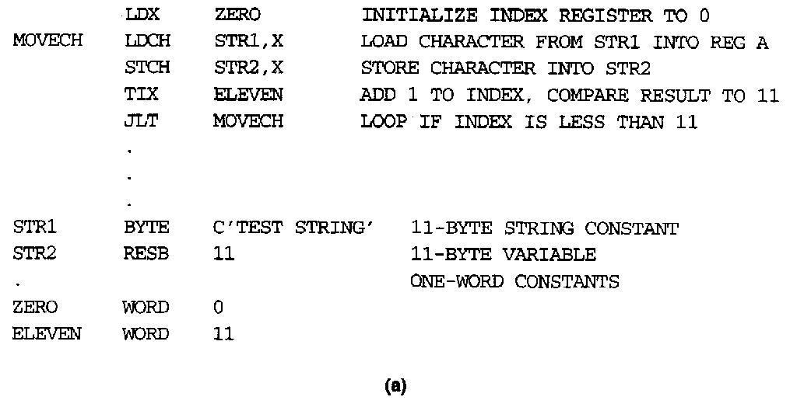
SIC Programming Example -- Looping and indexing (Fig. 1.4)

Slide 15
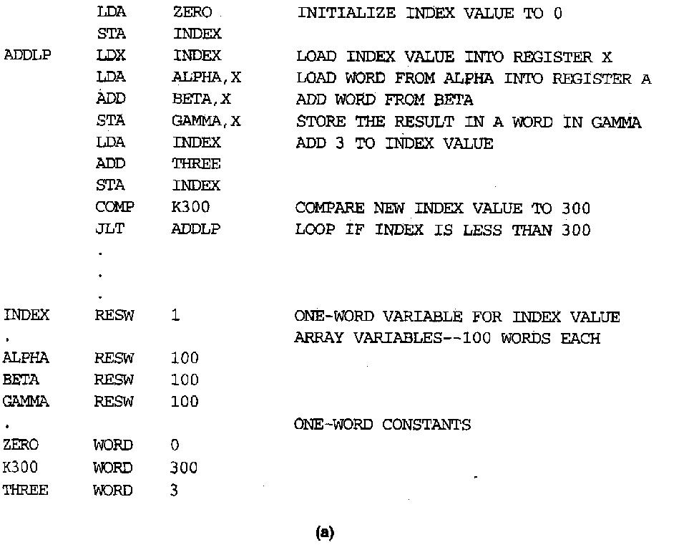
SIC Programming Example -- Looping and indexing (Fig. 1.5)
Arithmetic
Arithmetic operations are performed using register A, with the result being left in register A
Looping (TIX)
(X)=(X)+1
compare with operand
set CC
Break...
GAMMA[I]=ALPHA[I]+BETA[I]
I=0 to 100

Slide 16
SIC/XE Machine Architecture (1/4)
Memory
2²⁰ bytes in the computer memory
More Registers

Slide 17
SIC/XE Machine Architecture (2/4)
Data Formats
Floating-point data type: frac*2^{(exp-1024)}
frac: 0~1
exp: 0~2047
Instruction Formats
s
exponent (11)
fraction (36)

Slide 18
SIC/XE Machine Architecture (3/4)
How to compute TA?
How the target address is used?
Note: Indexing cannot be used with immediate or indirect addressing modes

Slide 19
Example of SIC/XE instructions and addressing modes

Slide 20
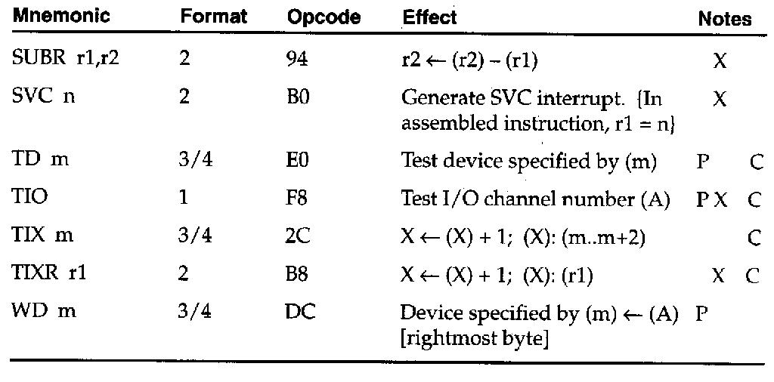

Slide 21
SIC/XE Machine Architecture (4/4)
Instruction Set
new registers: LDB, STB, etc.
floating-point arithmetic: ADDF, SUBF, MULF, DIVF
register move: RMO
register-register arithmetic: ADDR, SUBR, MULR, DIVR
supervisor call: SVC
generates an interrupt for OS (Chap 6)
Input/Output
SIO, TIO, HIO: start, test, halt the operation of I/O device (Chap 6)

Slide 22
SIC/XE Programming Examples (Fig 1.2)
ALPHA RESW 1
FIVE WORD 5
CHARZ BYTE C’Z’
C1 RESB 1
.
.
LDA FIVE
STA ALPHA
LDCH CHARZ
STCH C1
(a)
ALPHA RESW 1
C1 RESB 1
.
.
.
LDA #5
STA ALPHA
LDA #90
STCH C1
(b)

Slide 23
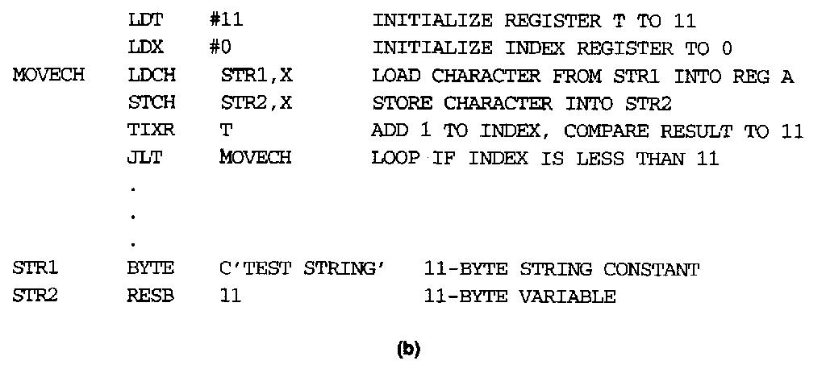
SIC/XE Programming Example -- Looping and Indexing Example (Fig 1.4)

Slide 24
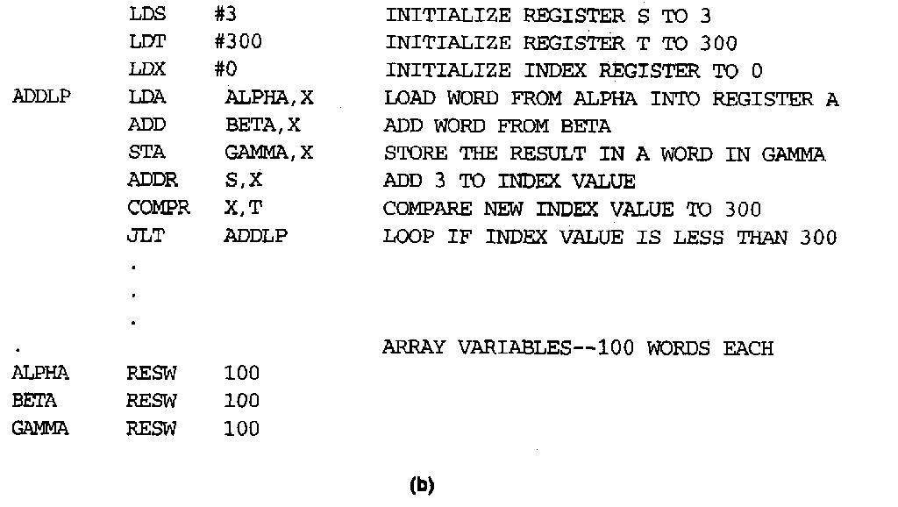
SIC/XE Programming Example -- Looping and indexing (Fig 1.5)

Slide 25
SIC/XE Programming Example
data movement
#: immediate addressing for SIC/XE
arithmetic
ADDR S,X
Looping (TIXR T)
(X)=(X)+1
compare with register specified
set CC
COMPR X,T

Slide 26
SIC Programming Example -- Sample Input and Output (Fig 1.6)

